Slide 1
The Mysterious Cube
Created by 포기남

Slide 2
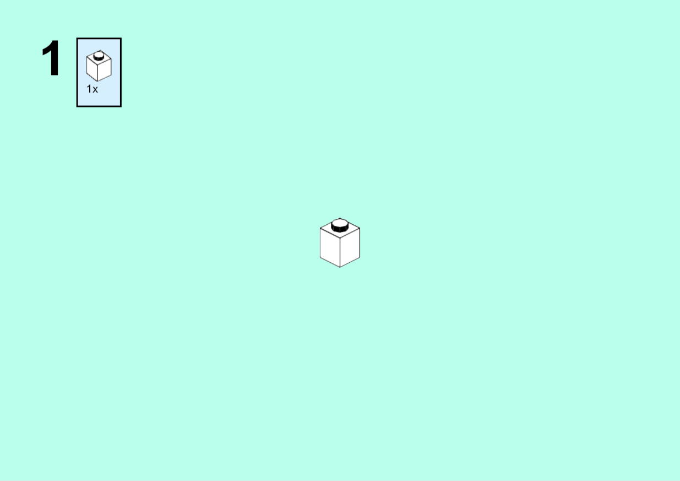

Slide 9
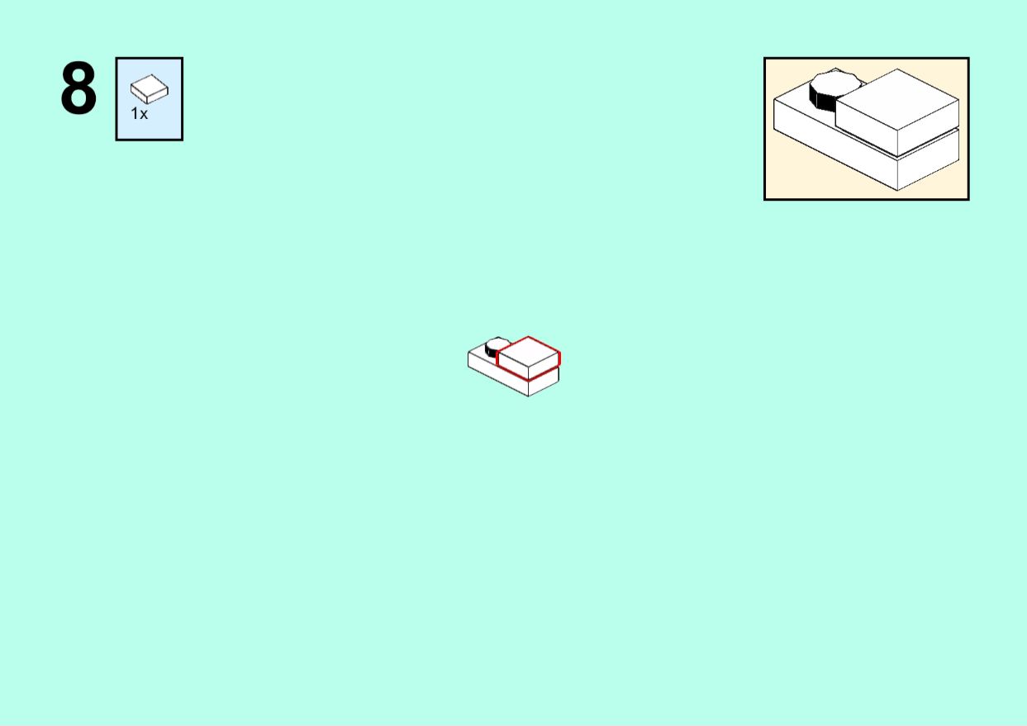

Slide 13
